Slide 1
Python visualization
Pie chart

Slide 2
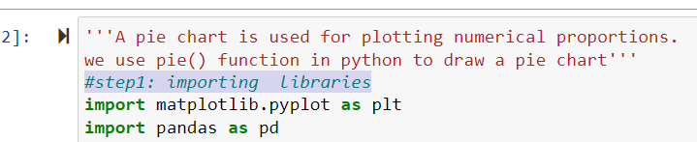
pie chart: '''A pie chart is used for plotting numerical proportions. we use pie() function in python to draw a pie chart'''
step1: importing python libraries

Slide 3
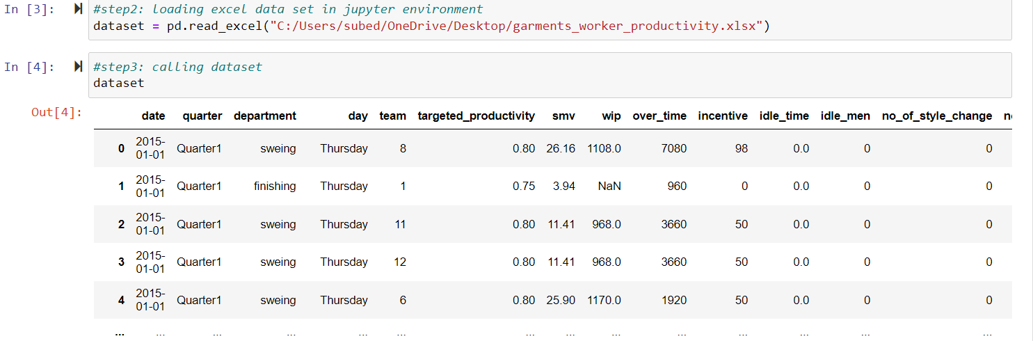
Step:2( loading data)

Slide 4
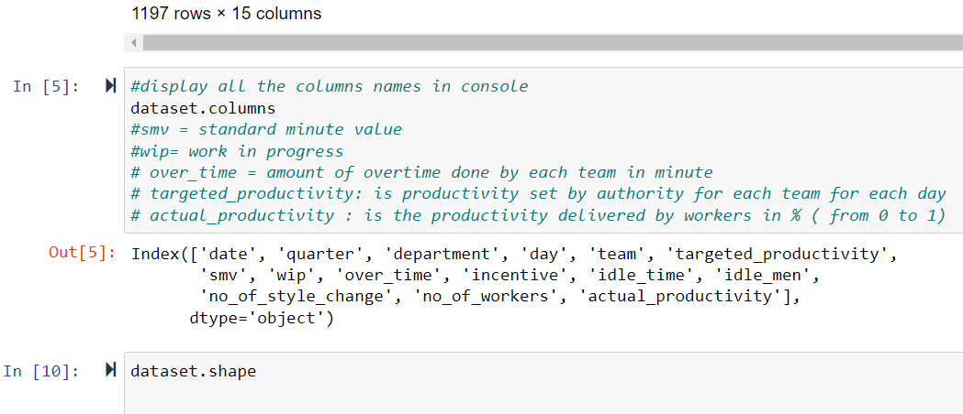
Step 3: Analyzing Data set

Slide 5
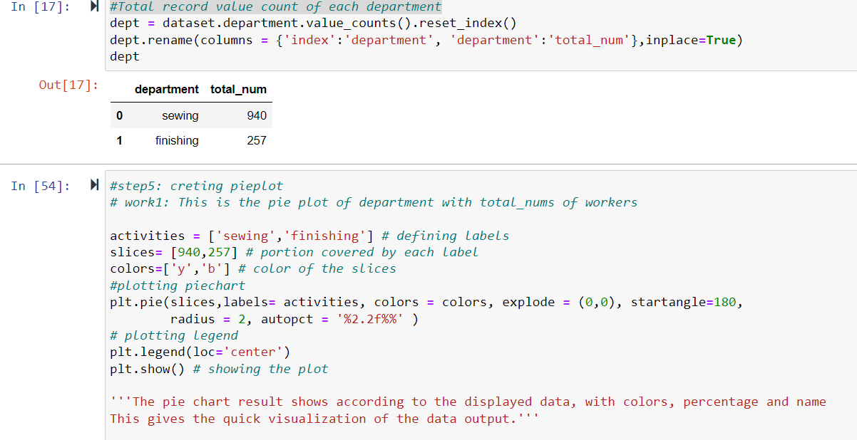
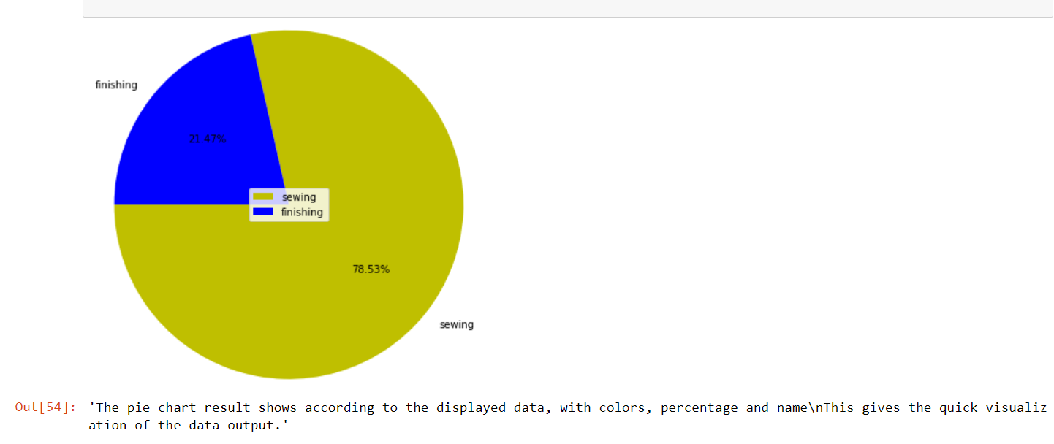
Step 4: Creating dataset to create pie chart

Slide 6
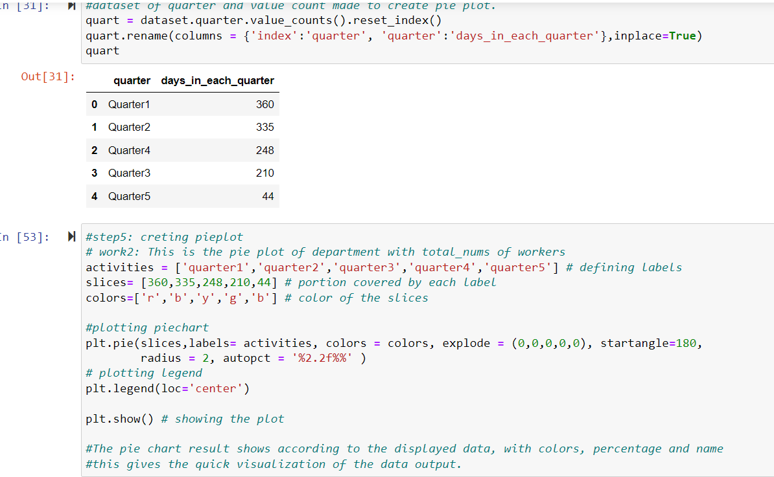
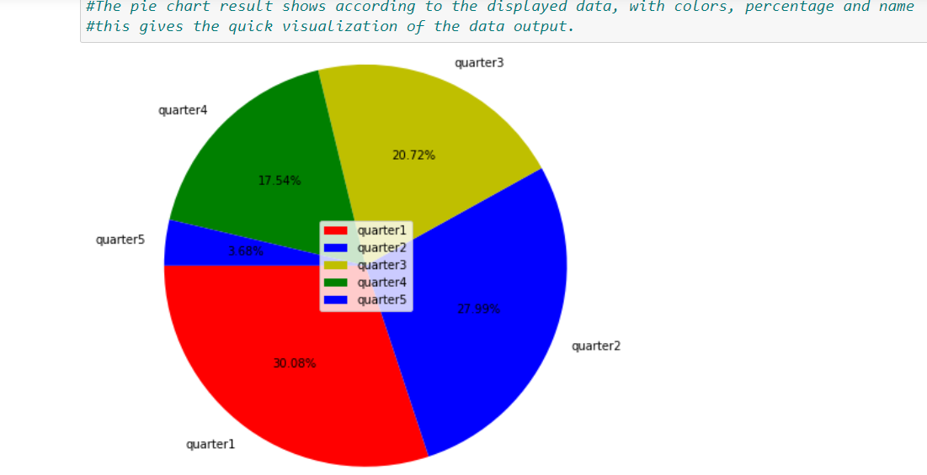
Example 2: worked days in each quarter with

Slide 7
Step5: Inference
The pie chart result shows according to the displayed data, with colors, percentage and name
this gives the quick visualization of the data output.
The most and least worked days are respectively in first and fifth quarter.
Similarly, The sewing department has almost 79 % of worked days than the finishing department.

Slide 8

Thank you

